Slide 1
The World Wide Web
Architecture
Web Document
HTTP
Web/Application server

Slide 2
ARCHITECTURE
The WWW today is a distributed client-server service, in which a client using a browser can access a service using a server. However, the service provided is distributed over many locations called sites. Each site holds one or more documents, referred to as Web pages. Each Web page, however, can contain some links to other Web pages in the same or other sites. In other words, a Web page can be simple or composite.

Slide 3
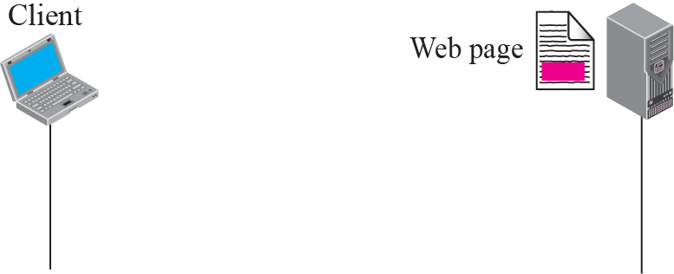
Assume we need to retrieve a Web page that contains the biography of a famous character with some pictures, which are embedded in the page itself. Since the pictures are not stored as separate files, the whole document is a simple Web page. It can be retrieved using one single request/ response transaction, as shown

Slide 4
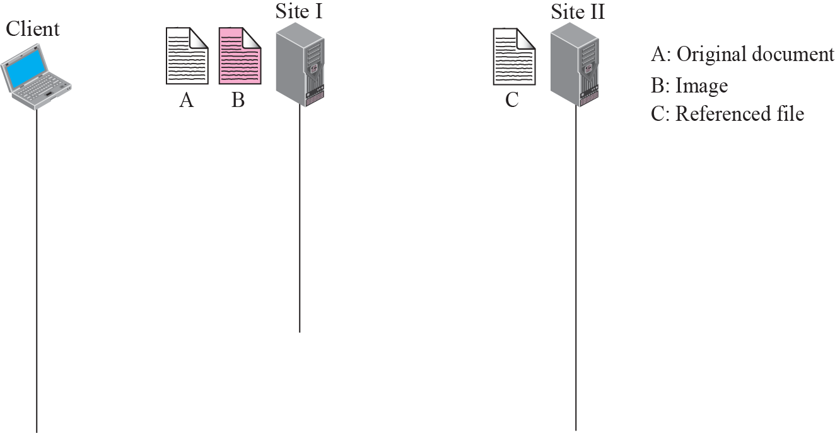




Now assume we need to retrieve a scientific document that contains one reference to another text file and one reference to a large image. Figure in the next slide shows the situation. The main document and the image are stored in two separate files in the same site (file A and file B); the referenced text file is stored in another site (file C). Since we are dealing with three different files, we need three transactions if we want to see the whole document. The first transaction (request/response) retrieves a copy of the main document (file A), which has a reference (pointer) to the second and the third files.

Slide 5
HTTP Request Format
request-line ( request request-URI HTTP-protocol version)
headers (0 or more)
<blank line>
body (only for POST request)
First type of HTTP message: requests
  Client browsers construct and send message
Typical HTTP request:
  GET http://www.cs.wisc.edu/index.html HTTP/1.0

Slide 6
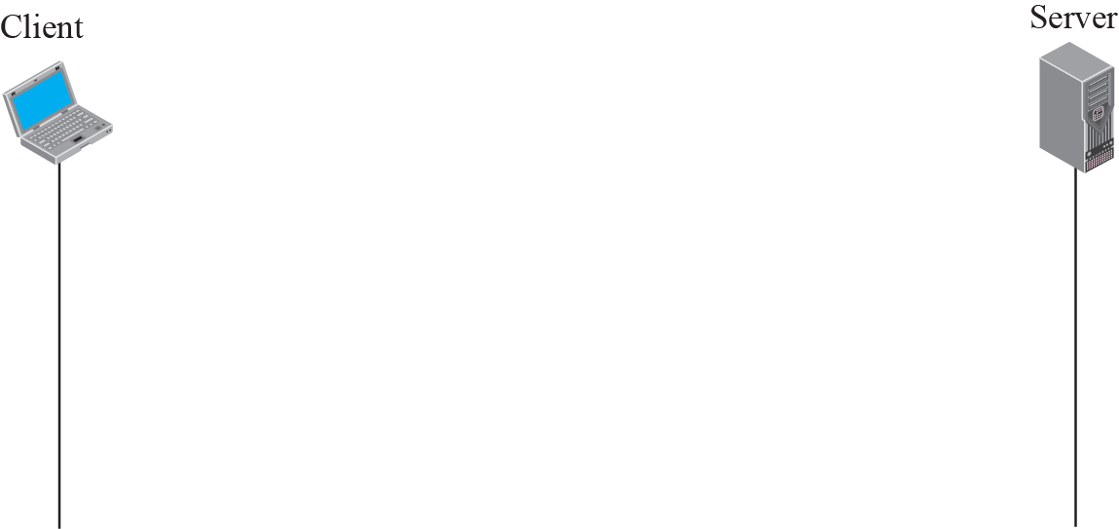
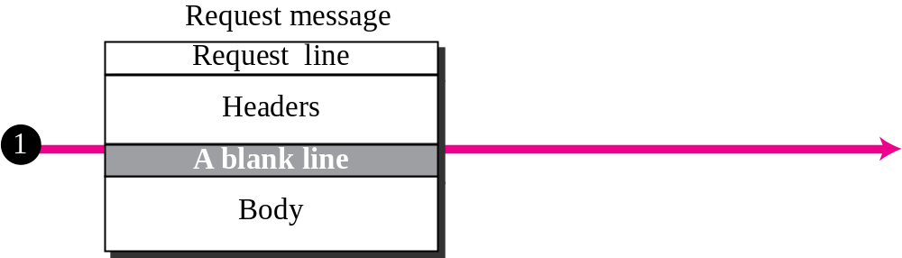
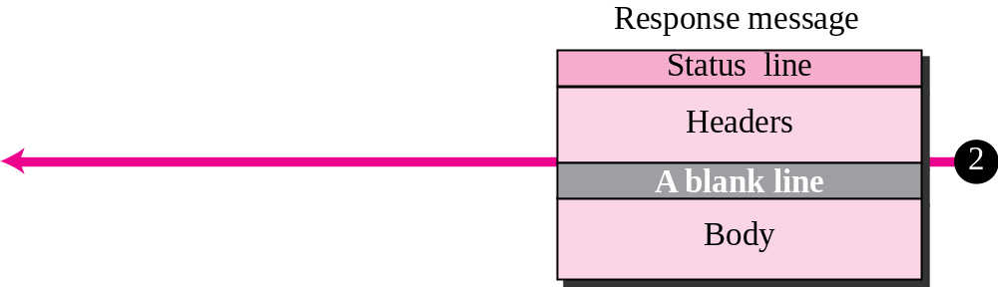

Slide 7
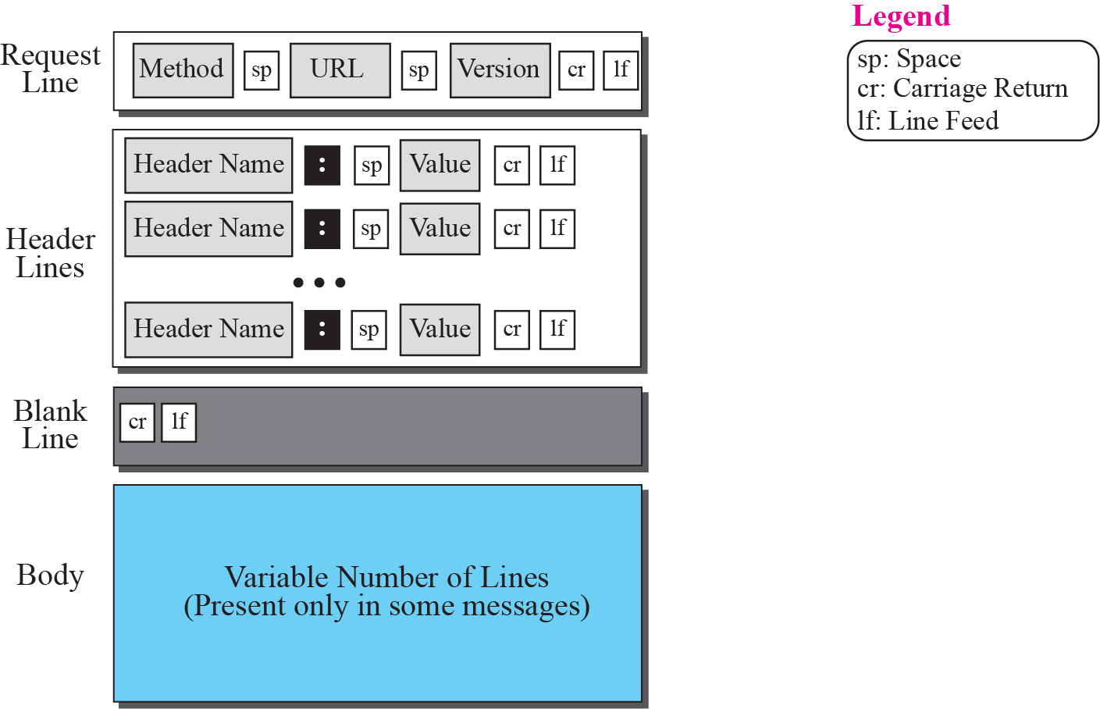
Figure 22.11 Format of the request message
TCP/IP Protocol Suite

Slide 8
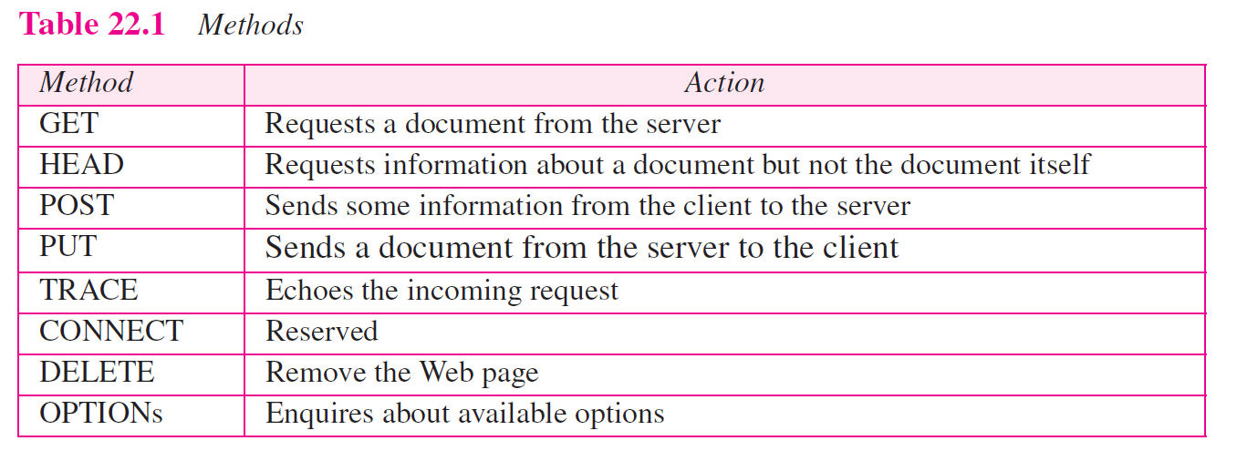
TCP/IP Protocol Suite

Slide 9
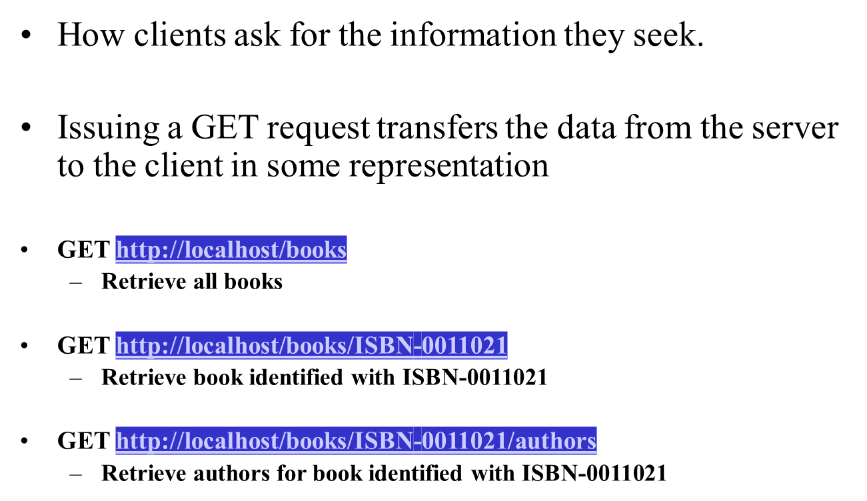
HTTP GET

Slide 10
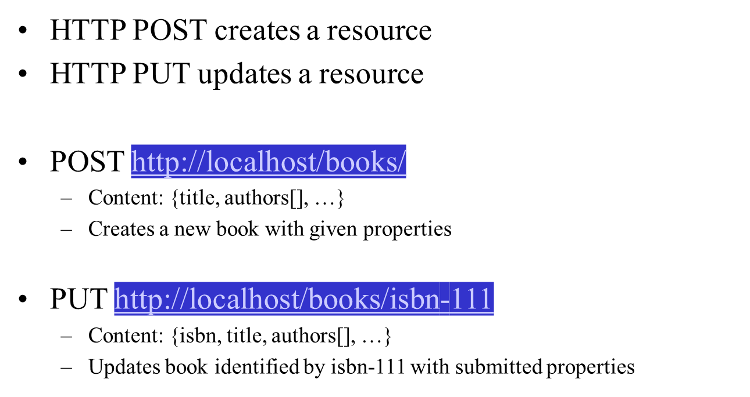
HTTP PUT, HTTP POST

Slide 11
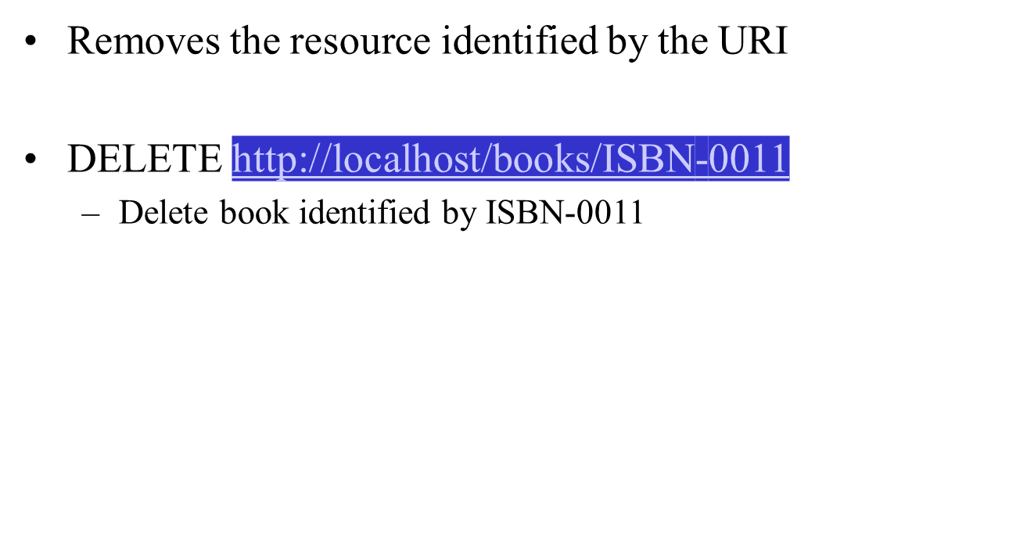
HTTP DELETE

Slide 12
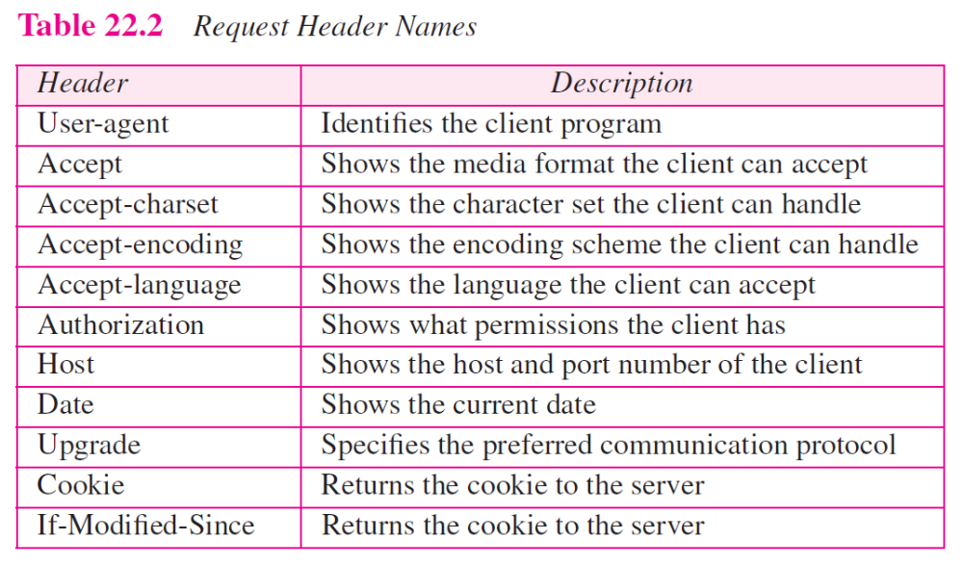
TCP/IP Protocol Suite

Slide 13
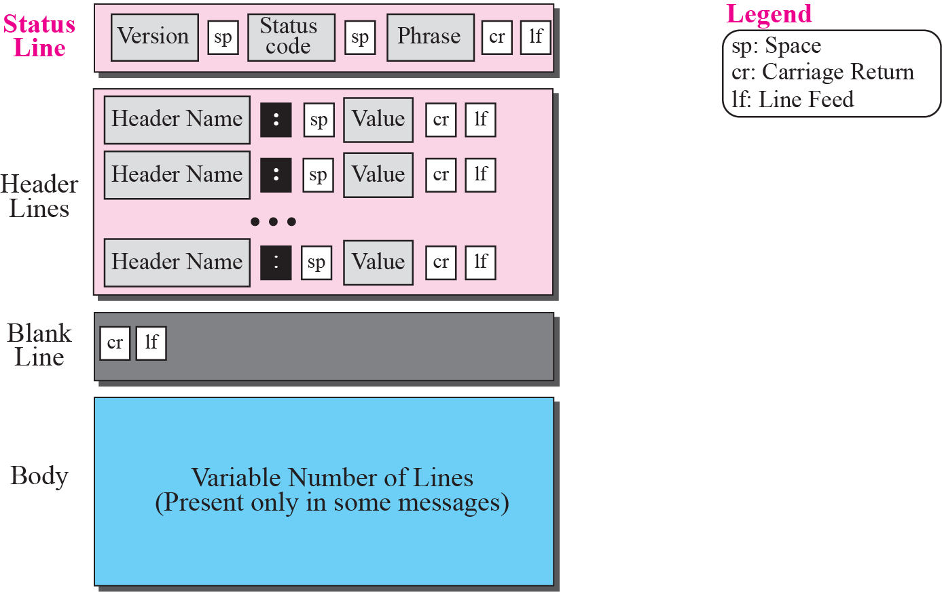
Figure 22.12 Format of the response message
TCP/IP Protocol Suite

Slide 14
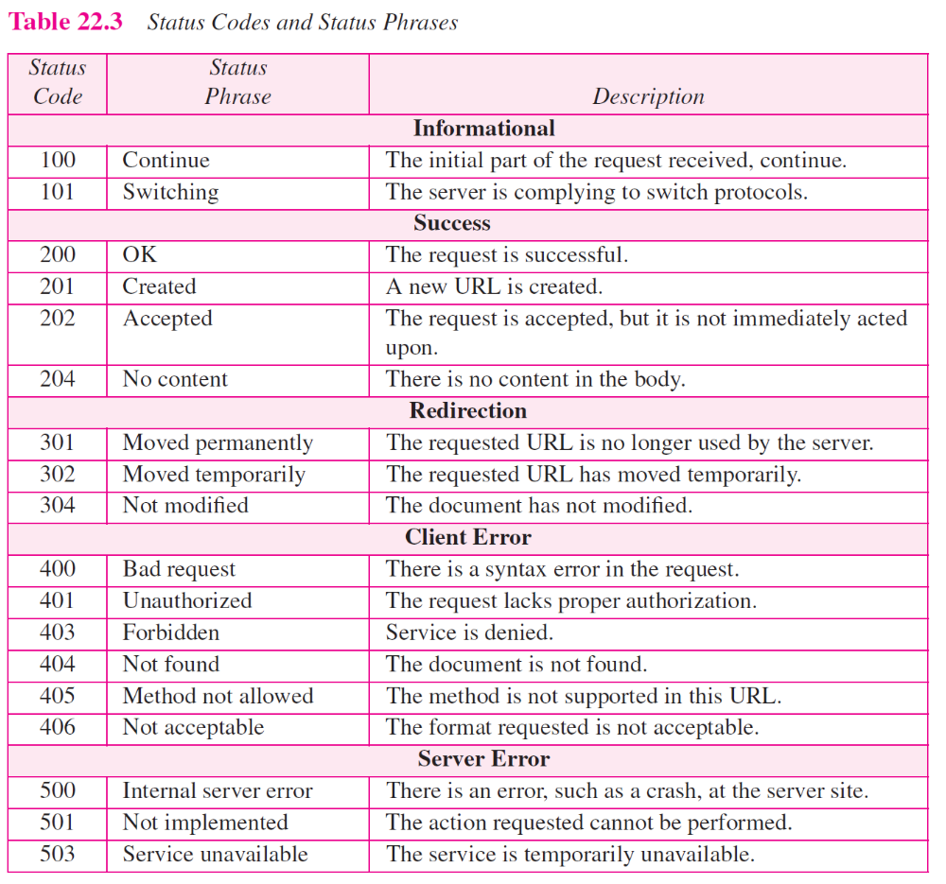
TCP/IP Protocol Suite

Slide 15
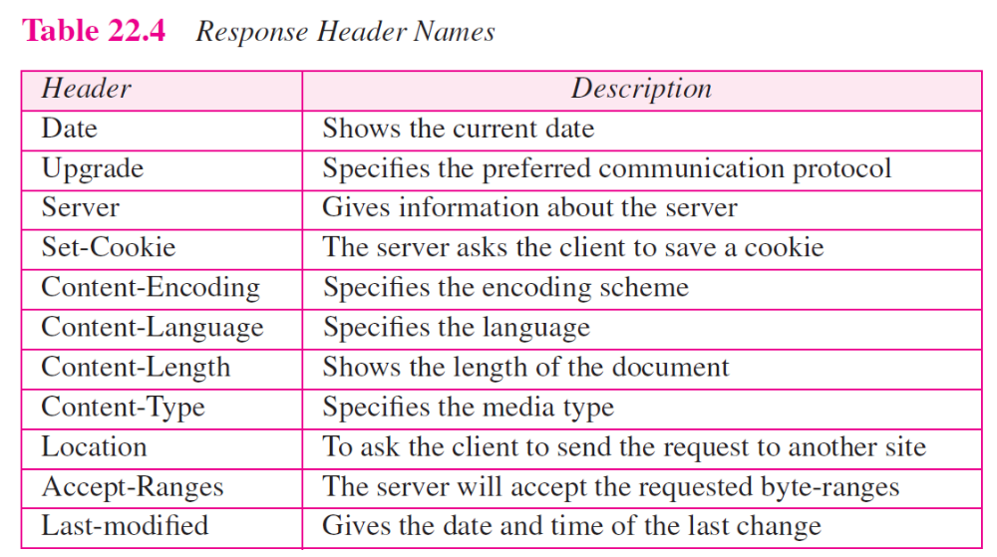
TCP/IP Protocol Suite

Slide 16
HTTP Response Format
status-line (HTTP-version response-code response-phrase)
headers (0 or more)
<blank line>
body
Second type of HTTP message: response
  Web servers construct and send response messages
Typical HTTP response:
  HTTP/1.0 301 Moved Permanently
  Location: http://www.wisc.edu/cs/index.html

Slide 17
Figure 22.12 Format of the response message
TCP/IP Protocol Suite

Slide 18
TCP/IP Protocol Suite

Slide 19
TCP/IP Protocol Suite

Slide 20
The next example retrieves a document (see next figure). We use the GET method to retrieve an image with the path /usr/bin/image1. The request line shows the method (GET), the URL, and the HTTP version (1.1). The header has two lines that show that the client can accept images in the GIF or JPEG format. The request does not have a body. The response message contains the status line and four lines of header. The header lines define the date, server, MIME version, and length of the document. The body of the document follows the header.
CS 640

Slide 21
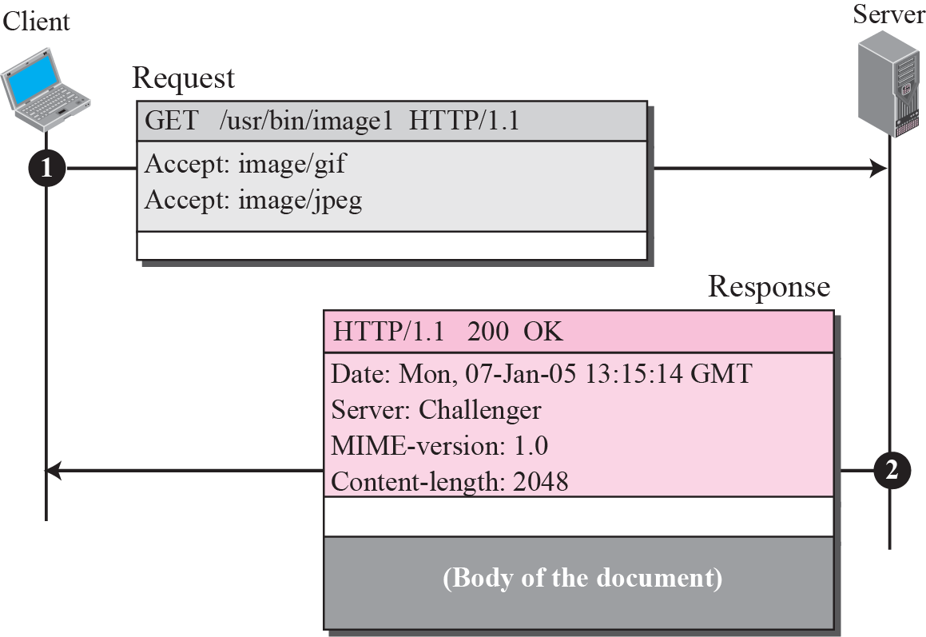
Figure 22.13 Example 22.4
TCP/IP Protocol Suite

Slide 22
Apache HTML Processing
Client
http://eagle.acadiau.ca/store15/index.html
Browser
HTTP
admin
Apache
HTTP Server
Internet
http/https
../store15/index.html

